Slide 1
ContentMine can
Automatically convert PDFs to semantic (computable) form
Identify different parts (equations and tables)
Gather parts into a computable metabolic network

Slide 2
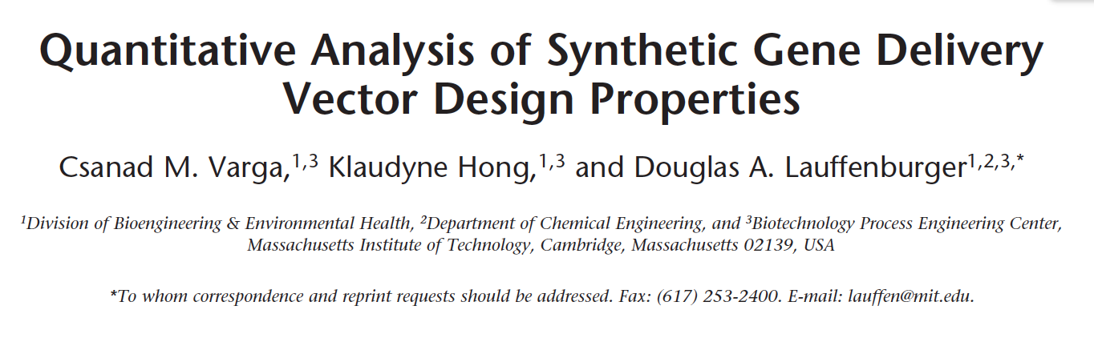
Extraction of equations (of metabolic networks) from PDFs
In human-readable and machine computable form.
Check for errors in paper
Enhance experience for humans
Add multidisciplinary knowledge
Example:

Slide 3
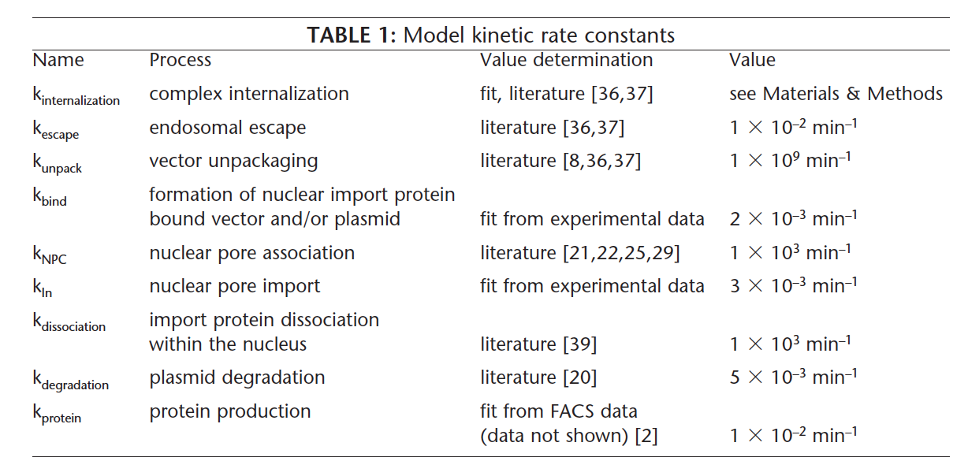
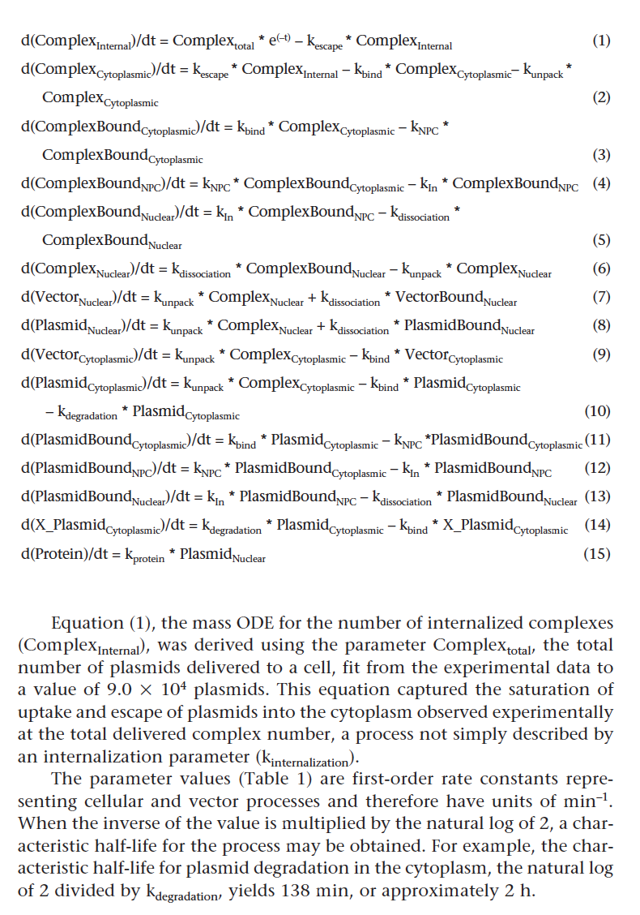
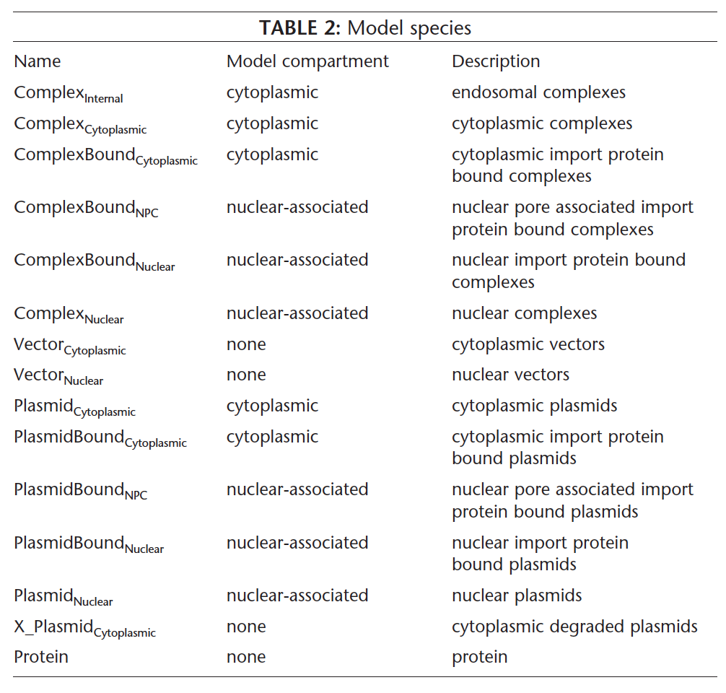
Metabolic network from Varga2001 in
PDF table form

Slide 4
Rate constants
Differential
Equations
Components
of the model
Metabolic network from Varga2001 in
PDF table form

Slide 5
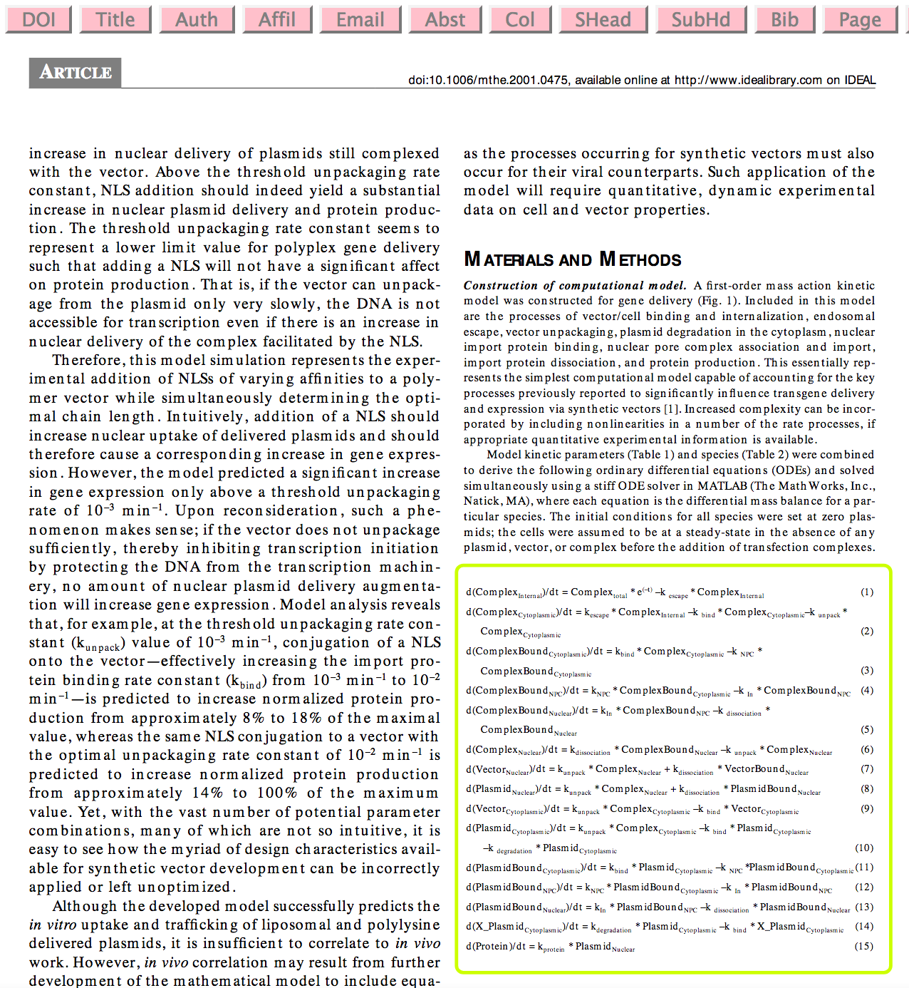
Extractors
ContentMine
PDF reader
Math Extractor

Slide 6
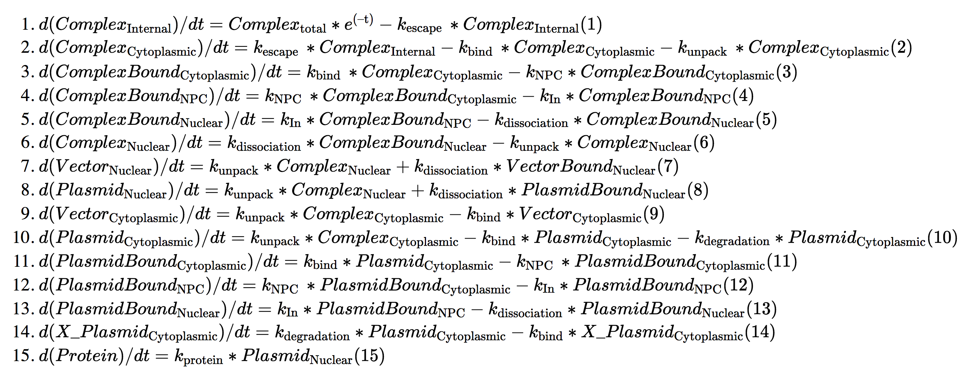
Response to equations Challenge
Matching sources and sinks in flow, 3-> 4

Slide 7
Rate constants
Differential
Equations
We used all 3 tables…
Components
of the model
Metabolic network from Varga2001 in
PDF table form

Slide 8
M
M
HW
M
M
HW
HW
…linking rate data to model species and equations automatically
machines
Humans + Wikipedia

Slide 9
M
M
HW
M
M
HW
HW
machines
Humans + Wikipedia

Slide 10
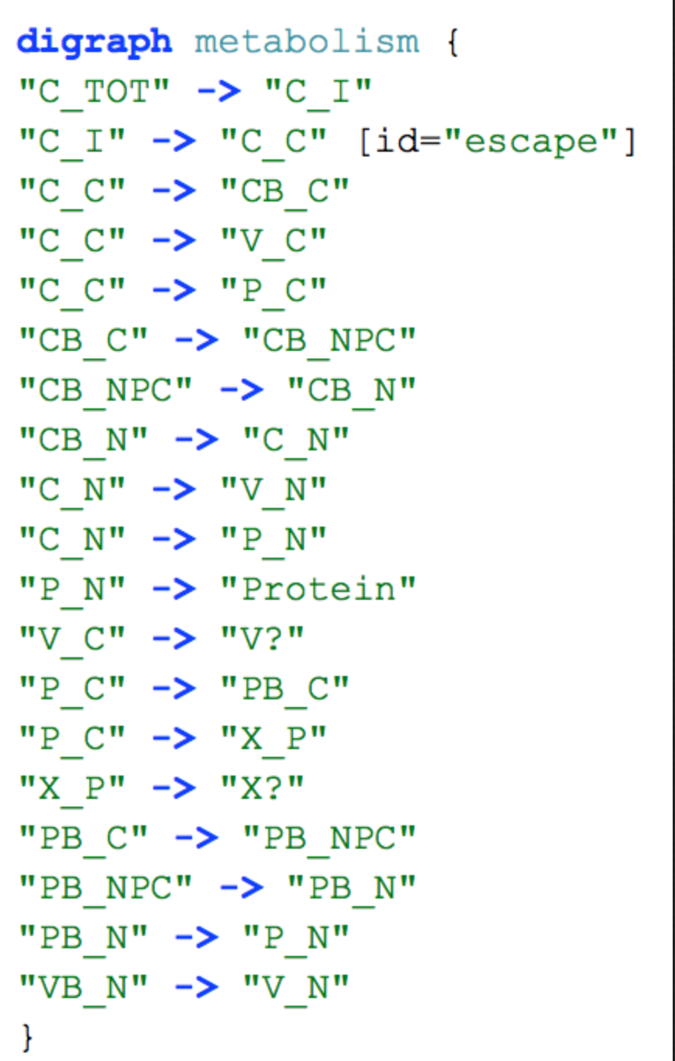
Simplify the syntax and reveal the network

Slide 11
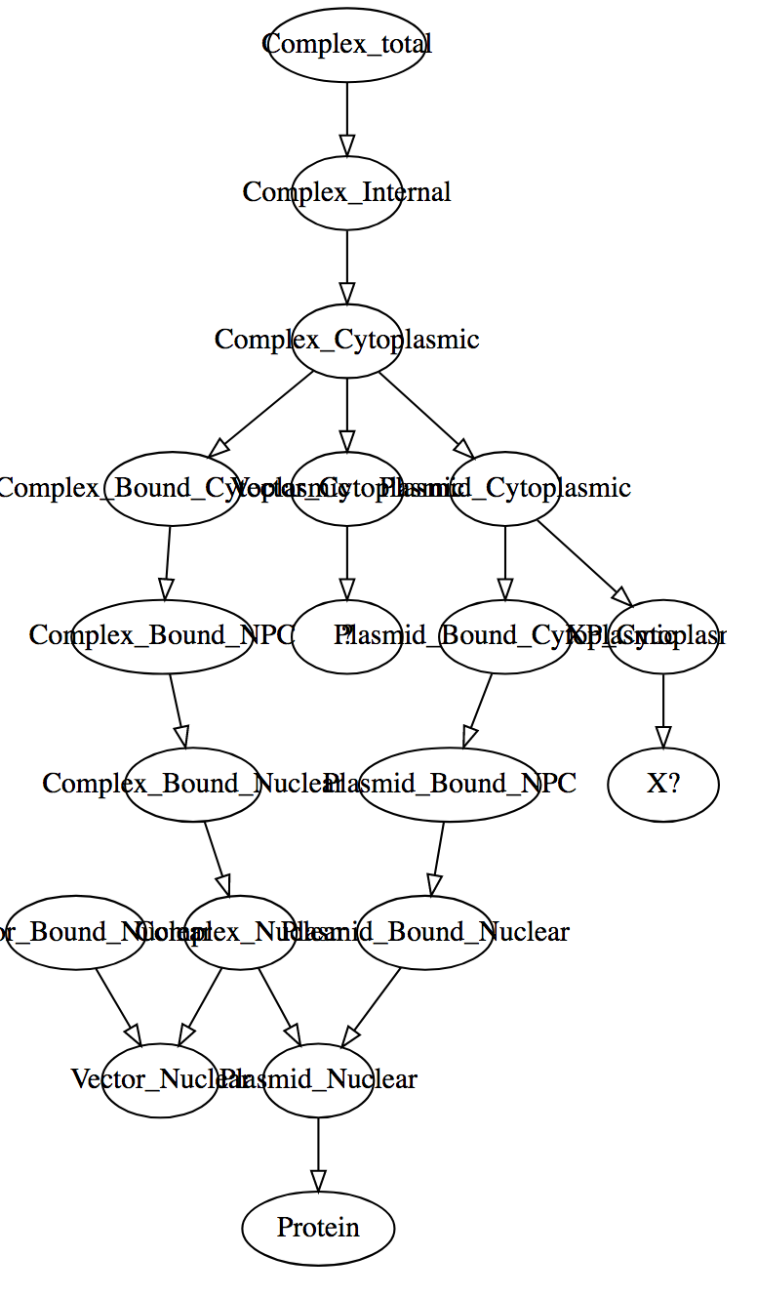
Raw network diagram.
arrows = equations
ellipses = components
Let’s declutter
Automatic!

Slide 12
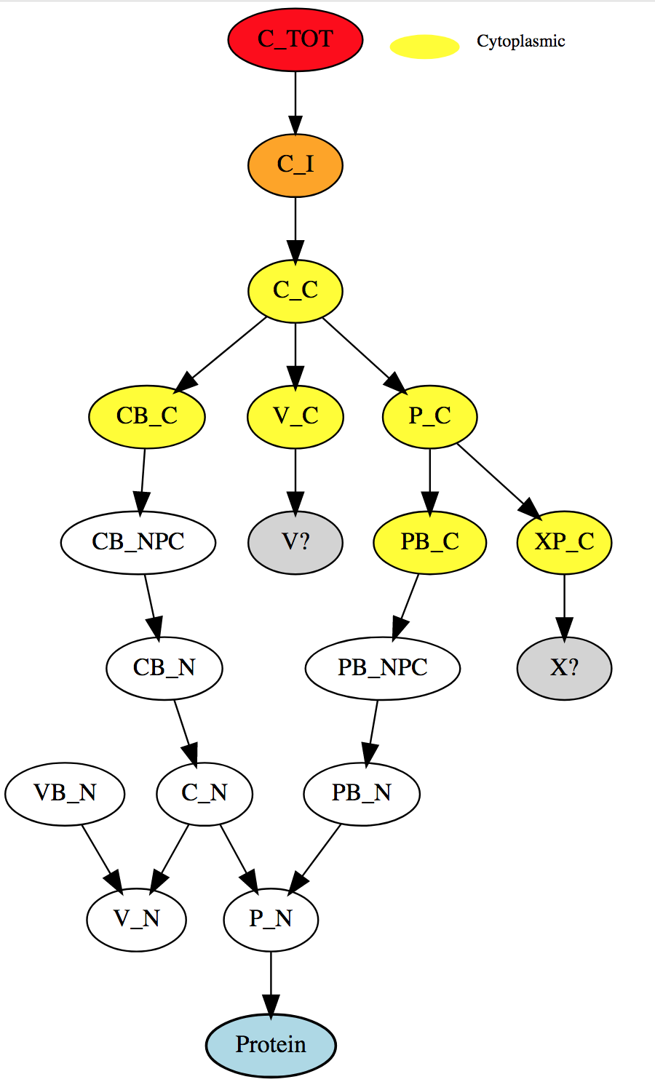
Compartments:
Yellow = .*Cytoplasmic
Automatic!

Slide 13
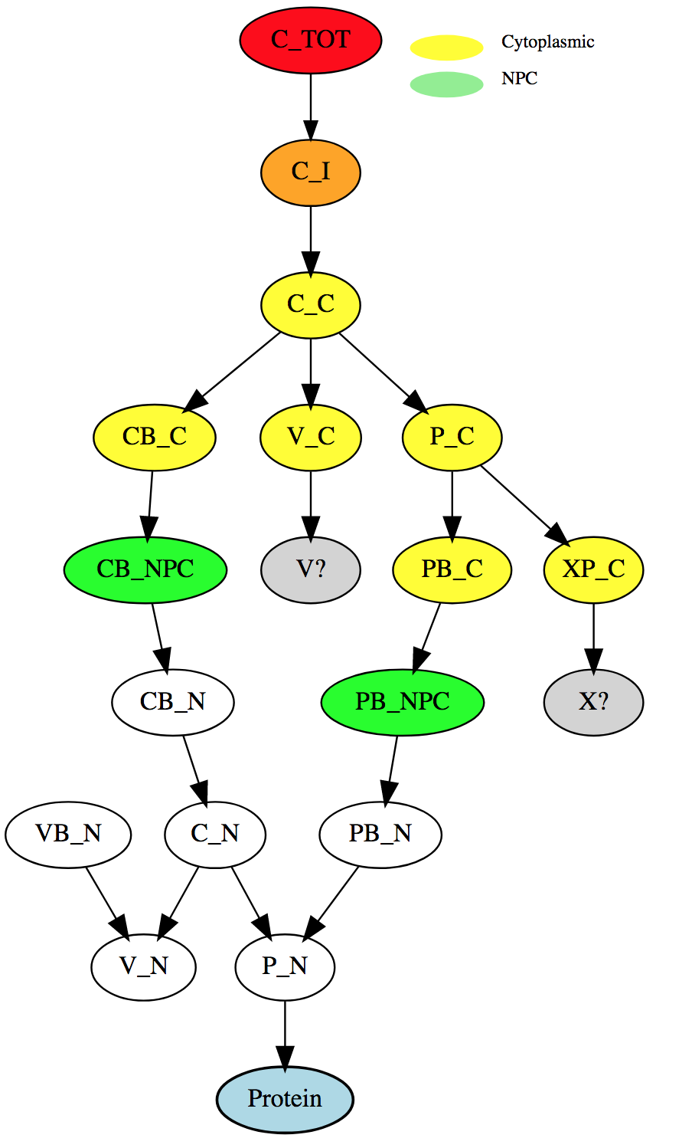
Compartments:
Green = .*NPC
Automatic!

Slide 14
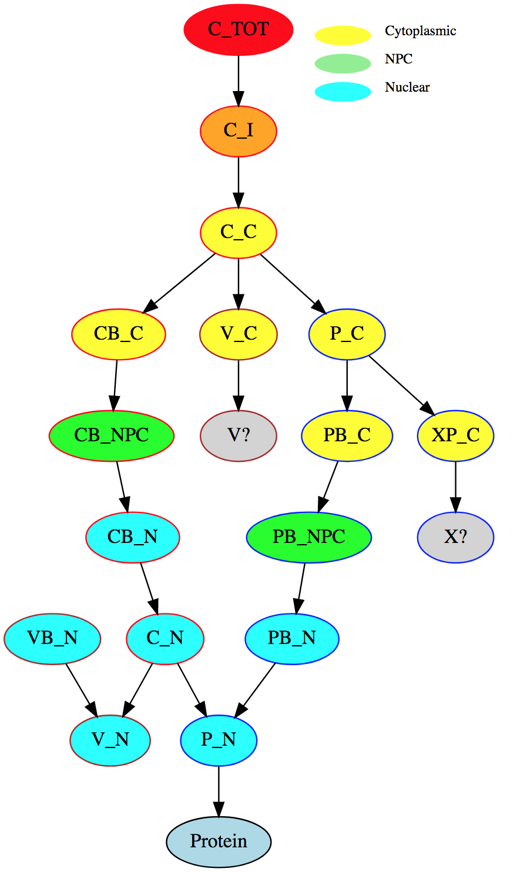
Compartments:
Cyan = .*Nuclear
Automatic!

Slide 15
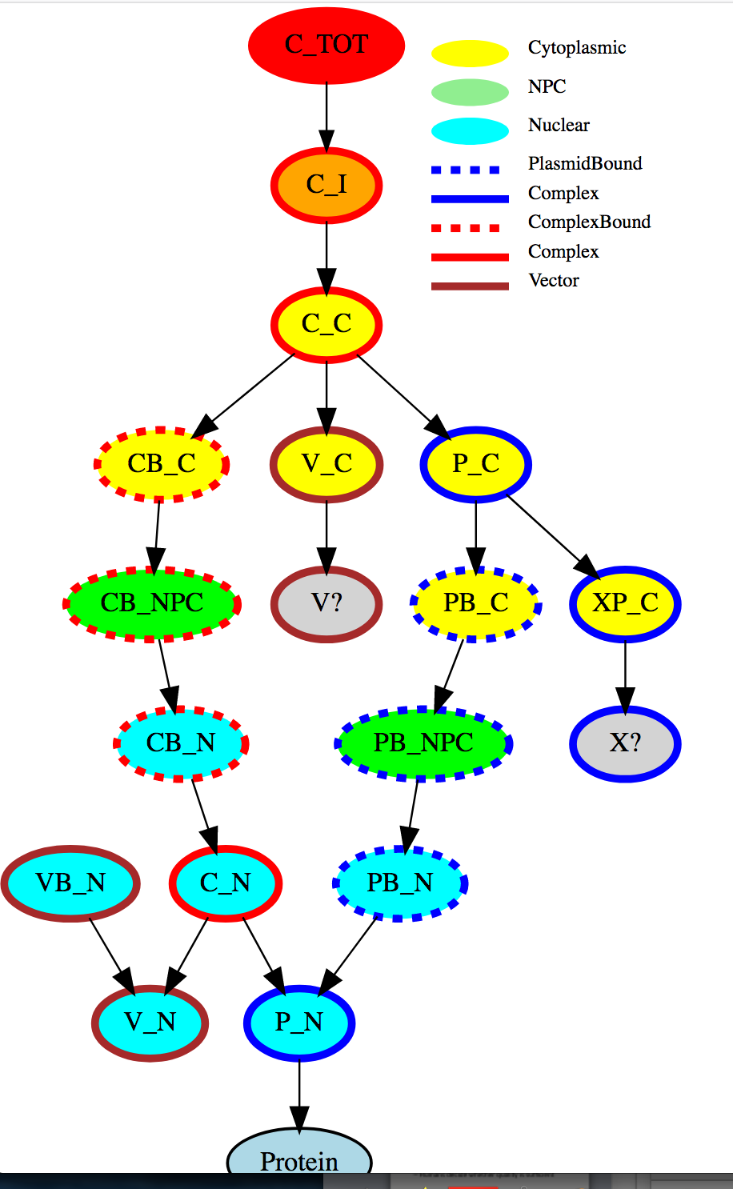
Complex/Plasmid/Bound
Variable stroke style
Automatic!

Slide 16
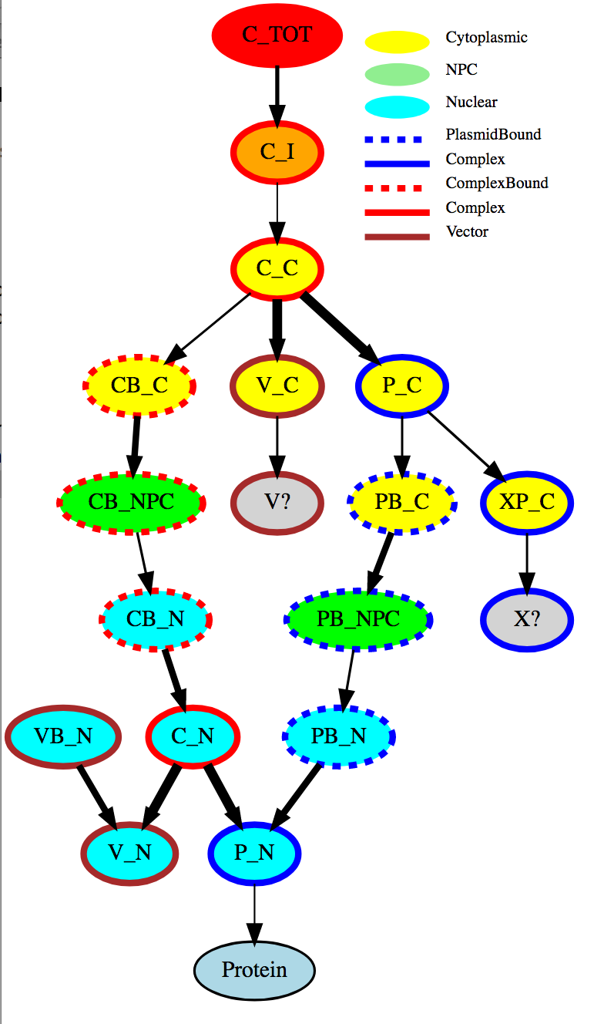
Rate constants
10⁹
10⁻³
Automatic!

Slide 17
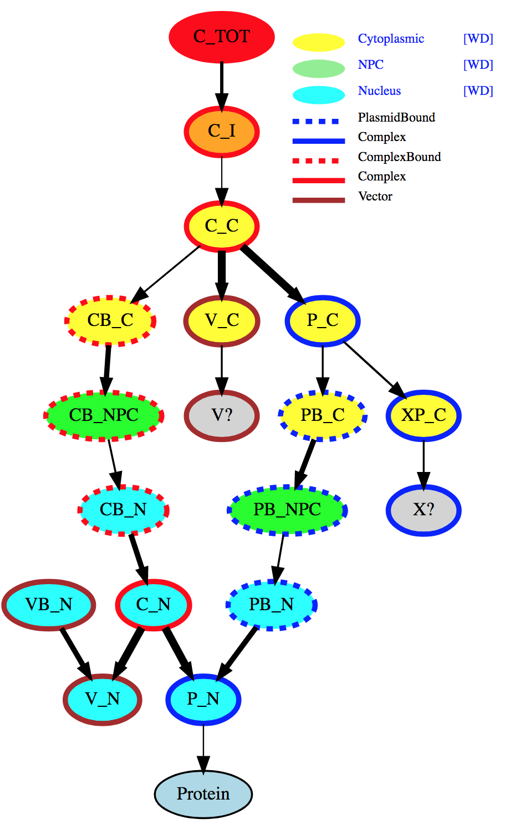
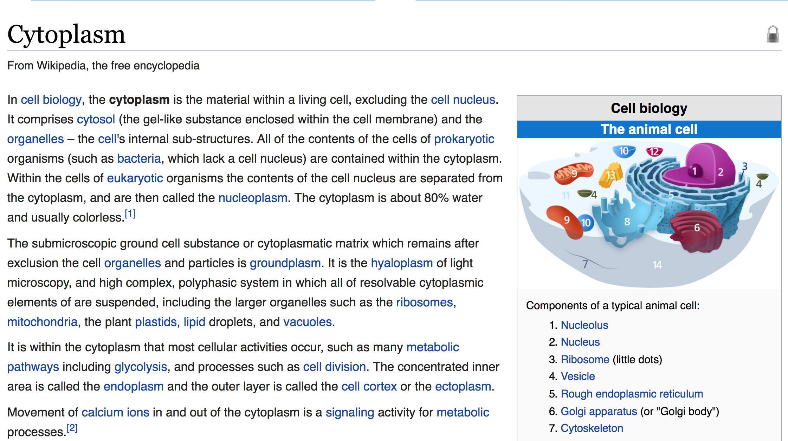
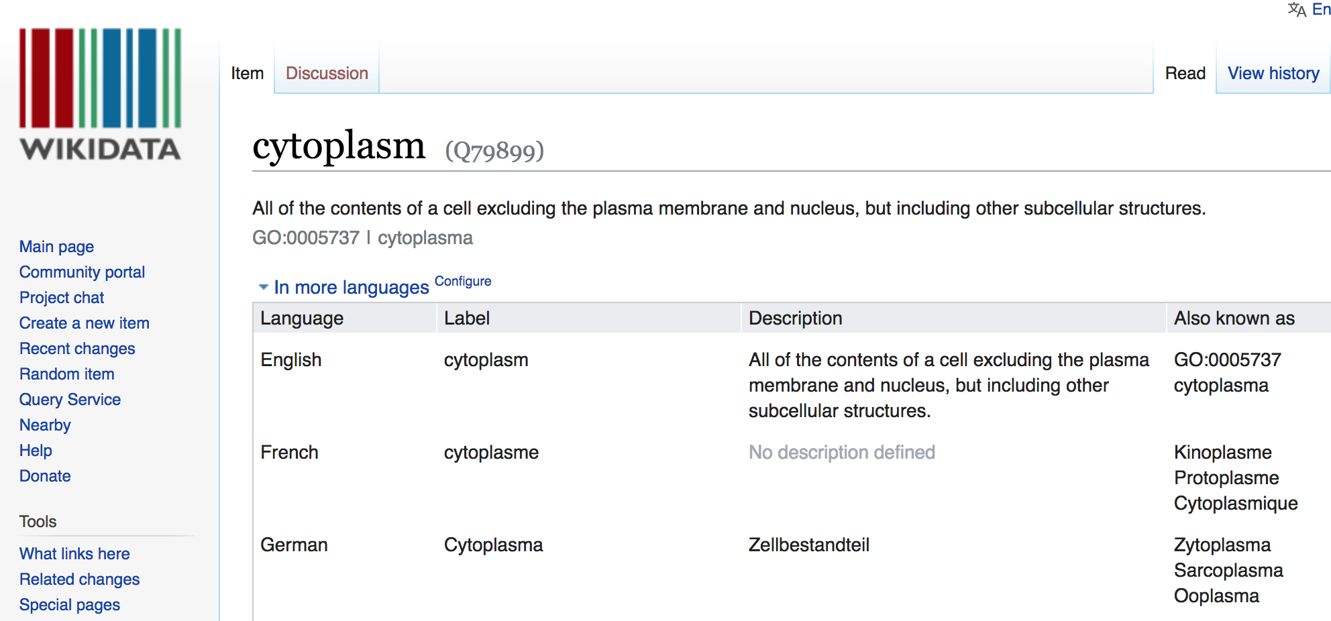
Link to Wikipedia and Wikidata
Automatic!

Slide 18
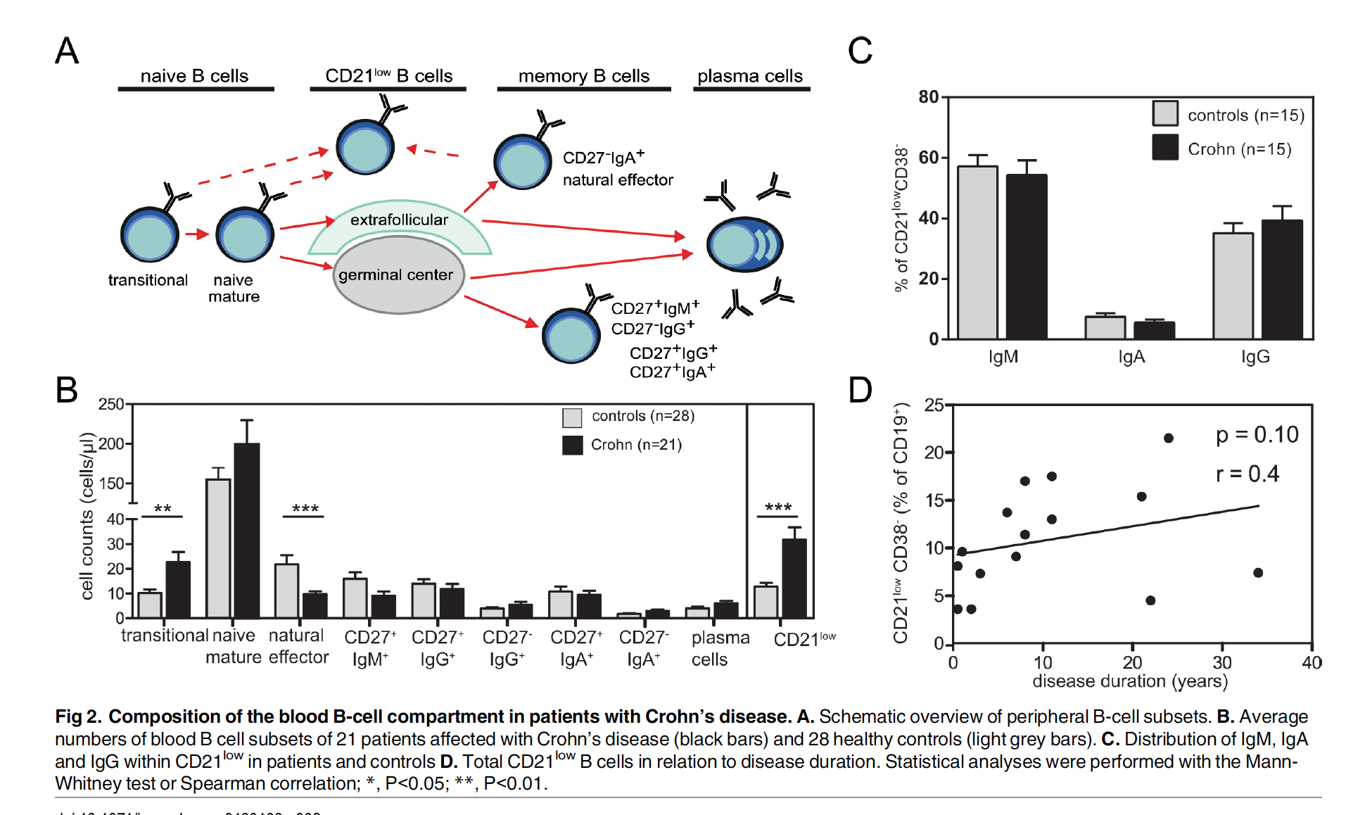
ContentMine can extract data from plots
(a) Semantic sectioning (b) extraction from caption (C) extraction to CSV/XSLX

Slide 19
END

Slide 21
Matching sources and sinks in flow, 3-> 4

Slide 22
Machine-human assistance
Machine-assisted human review
Machines do the time-consuming, boring and error-prone parts
Machines link to additional knowledge
Machines compute properties
Machines spot errors in articles
Human-assisted machine extraction
Humans decide in each paper what to extract
Humans decide whether quality is sufficient

